Slide 1
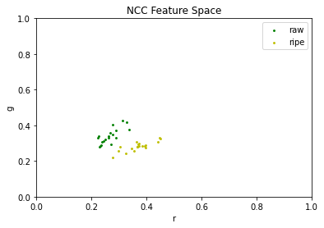
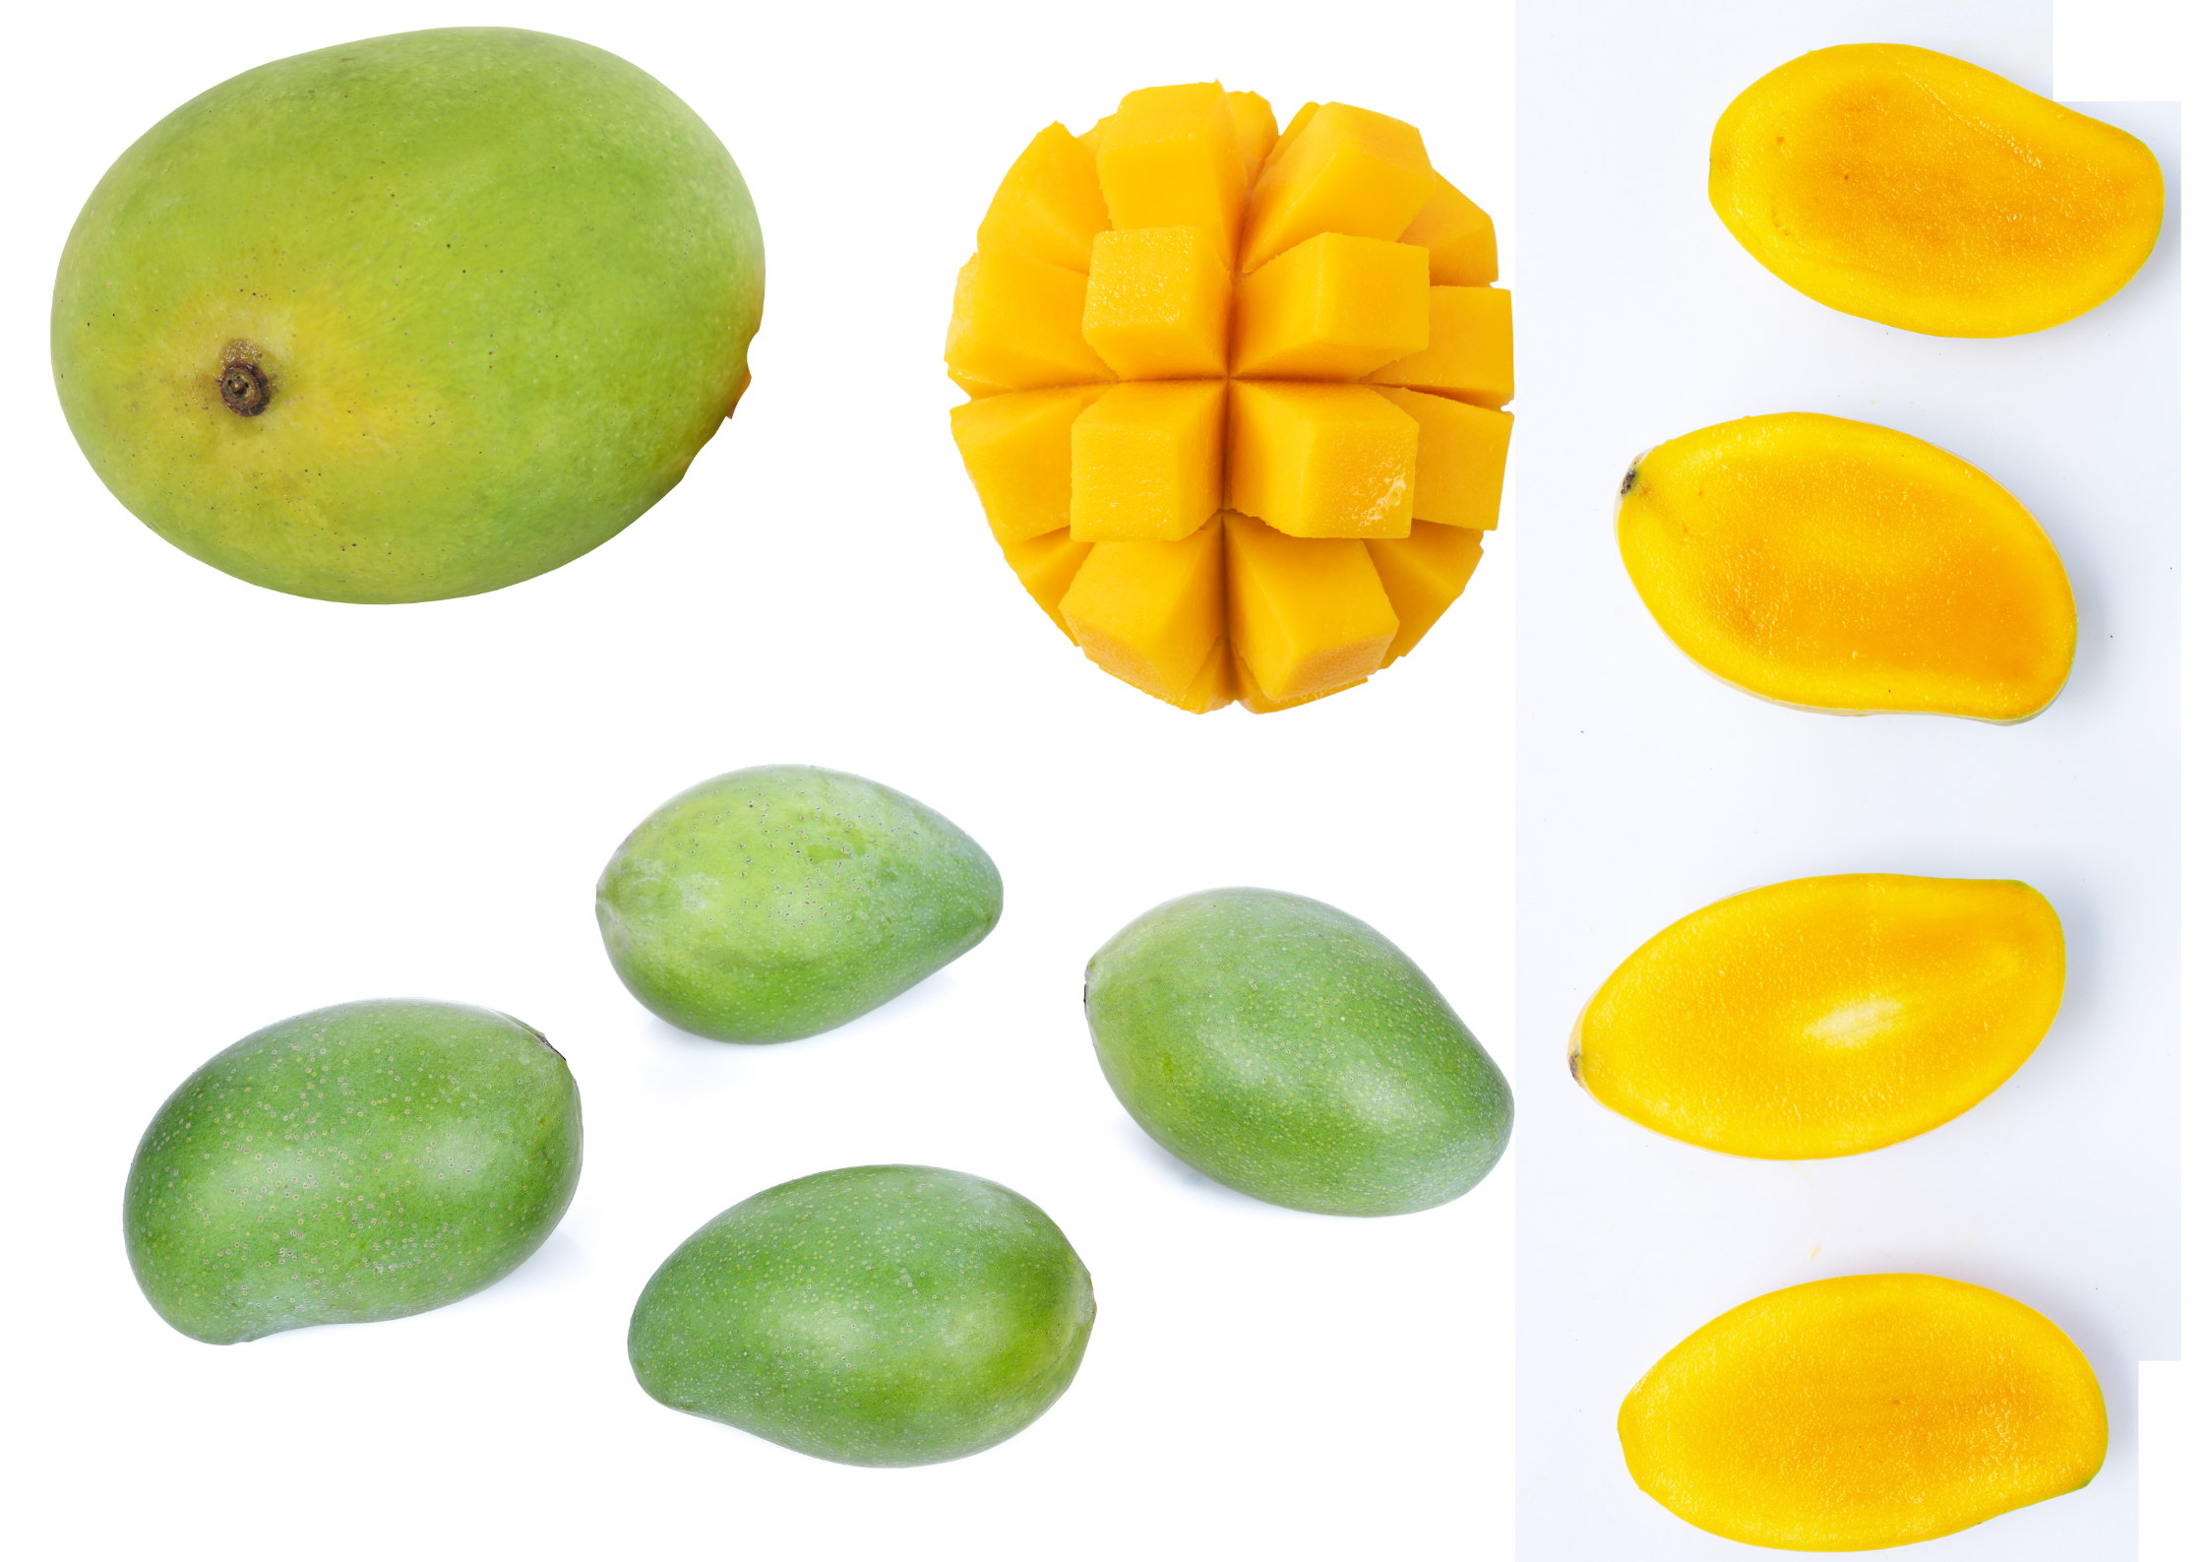
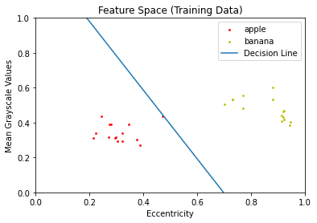
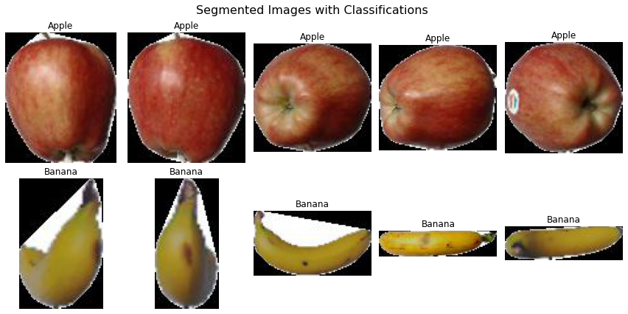
Machine Learning (Supervised): Perceptron and Logistic Regression
App Physics 157 FX-1 1 of 5
Presented by Soriano, Edneil E. Jr.
S.N. 202002420

Slide 2
Objectives
App Physics 157 FX-1 2 of 5
To extract the appropriate features in two classes of objects to train a classifier sufficiently.
To train a perceptron in classifying two linearly separable classes in feature space using the McCulloch-Pitts Neuron (MCP) as a framework.
To apply linear regression in making a probabilistic model as opposed to the earlier “hard” binary classifier.

Slide 3
App Physics 157 FX-1 3 of 5
Perceptron
The decision line is not unique because initial weights are randomized for later adjustment; and while all these lines are valid - not all are useful. In our particular case, it took me 2 runs of 1000 epochs each in order for the perceptron to correctly classify all the test data shown in Fig 2.
In this exercise, we simulate an artificial neuron but we let it evolve through thousands of iterations, making it “learn” the ideal weights of each of its inputs. This artificial neuron could then classify between two linearly separable classes by constructing a decision line as shown in Fig 1.
Fig 2. The perceptron algorithm can now classify apples and bananas
Fig 1. Two classes (apple and banana) defined by two features (mean grayscale and eccentricity) separated by a decision line.
This particular decision line predicts with a score of 100% for this particular test data. We can also see how the perceptron algorithm can create a binary classifier given a limited amount of training data. This perceptron WILL now work for any two features and any two classes of objects!
We employ usual feature extraction techniques on 15 apple and banana images each to get the feature space shown above.

Slide 4
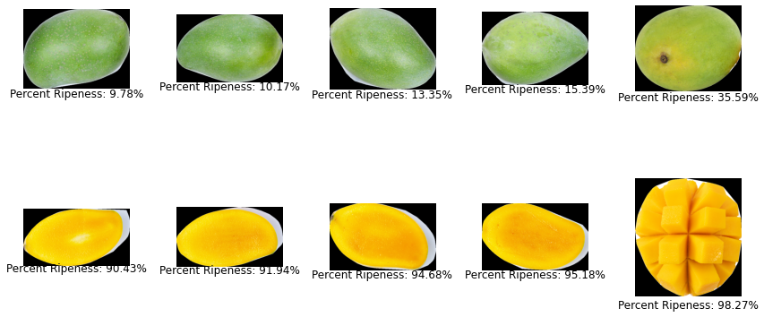
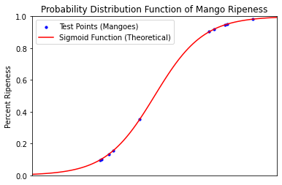
App Physics 157 FX-1 4 of 5
Logistic Regression
Suppose we now want to classify an object based on a spectrum (such as ripeness)? All we do is replace the step function with a sigmoid, or another continuous probability distribution. In the title page, we show the training data in Normalize Chromaticity Coordinates (NCC) as our feature space. In logistic regression, the output is not a binary -1 or +1 but a continuous distribution from 0 to 1. After training with 19 mangoes for each class, we test 10 test mangoes for ripeness as shown in Fig 3.
Fig 4. Test mangoes and their corresponding ripeness based on color
As expected green mangoes were classified to a “probability” of less than 0.5, with yellow mangoes classified to higher values. For this particular model, I designed the training to only take into account 2 features to mimic the previous activity. However, it is actually very straightforward to take into account a number of other features – it’s just a matter of increasing the size of weight vectors in the code. Lastly, I wanted to touch on the learning rates used for both models’ weight change rules. The learning rate I used for logistic regression was 2 orders of magnitude higher than what I used for the perceptron! When training different models, this is important to not only for it to work but also to avoid overfitting.
Fig 3. Test points overlayed with the sigmoid threshold function to show how probabilities are assigned.

Slide 5
Key Takeaways
App Physics 157 FX-1 5 of 5
Classifiers can be trained to treat binary or continuous data solely based on the thresholding function used.
Making machine learning models is sometimes an art (like using morphological operators) because you need tailor it to the data on hand and some parameters are entirely up to the user’s judgement.
Reflection
Out of all the activities done this semester, this is my favorite and probably where my motivation peaked. I’ve heard the word “machine learning” multiple times before but to me it’s just another buzzword that I don’t fully understand. And while yes, as part of my research experience in the institute I was tasked to train models that are more complicated than these ones; but creating them from scratch using nothing but linear algebra gave me a new sense of appreciation and understanding for these classifiers. Now, whenever I use readily available libraries such as TensorFlow I can confidently say that I know how they work! However if we have too much features, it becomes hard to draw conclusions from the dataset. This is where Principal Component Analysis (PCA) comes in! Unfortunately, it is beyond the scope of this course, but I will definitely study it after this semester (next 2 weeks)!
I did all the necessary tasks stated in the module and the models I trained were very accurate. I had to apply every past activity for feature extraction – which isn’t something we always do manually since there are tools and sources for data everywhere these days. Hence, I think I deserve a 100/100 and any bonus points the instructor deems necessary!
References
[1] Soriano, M. (2023). ML2 - Perceptron. App Physics 157. National Institute of Physics, UP- Diliman.
[2] Soriano, M. (2023). ML3 – Logistic Regression. App Physics 157. National Institute of Physics, UP- Diliman.
[3] McCulloch, Warren S., and Walter Pitts. "A logical calculus of the ideas immanent in nervous activity." The bulletin of mathematical biophysics 5, no. 4 (1943): 115-133

